Slide 1
Case Study 2 Joiner & Sons Omnichannel

Slide 2
Question 1: Using a single page, create a graphic flow diagram which includes activities involved in each proposed channel. Proposed starting at receipt at our distribution center from our suppliers to receipt by the customer. Use a unique color (designated below) for the flow of each channel:
A. Red: Traditional retail
B. Blue: BOPUS (order online/pickup at store)
C. Green: BODDC (order online/deliver from DC)
D. Brown: BODFS (order online/deliver from store)

Slide 3
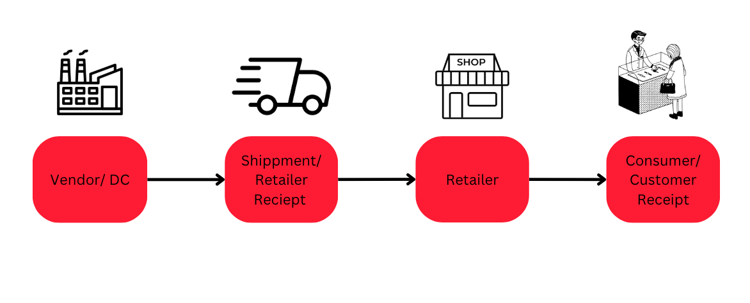
Traditional Retail:
Notes:
Goods are sold from vendor to retailer
Shipment and recipient is charged
Goods are stored at physical retail store
Consumers shop and are charged
Recommend speaking about the process in joiner & sones hardware terms

Slide 4
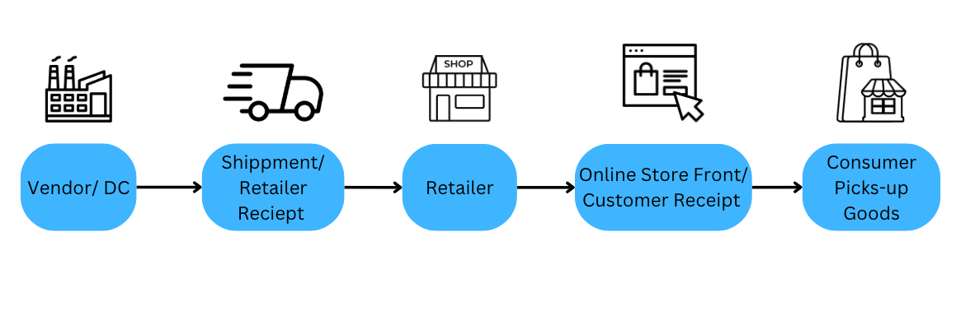
Buy Online Pickup at Store (BOPUS):
Notes:
1) Goods are sold from vendor to retailer
2) Shipment and recipient is charged
3) Goods are stored at physical retail store
4) Consumer interacts with online storefront where they are charged
5) Consumer/customer picks-up goods at physical retail store
Recommend speaking about the process in joiner & sones hardware terms

Slide 5
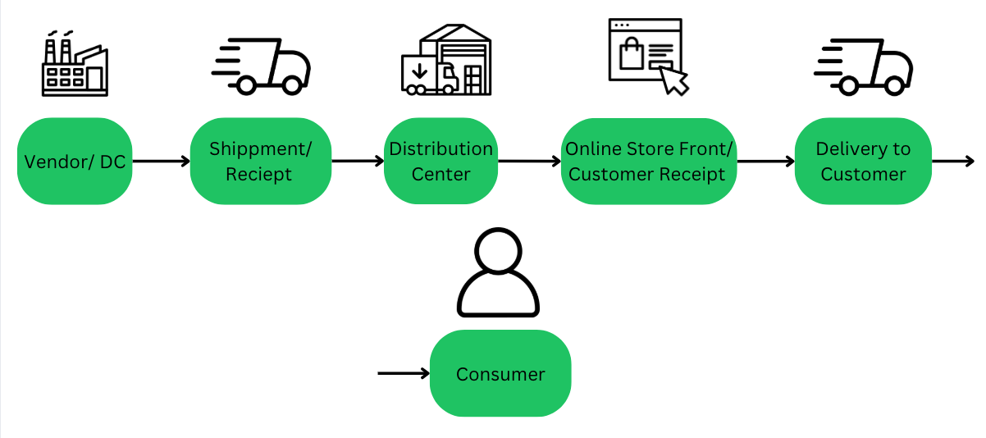
Buy Deliver from Distribution Center (BODDC):
Notes:
1) Goods are sold from vendor to retailer
2) Shipment and recipient is charged
3) Goods are stored at distribution center
4) Consumer interacts with online storefront where they are charged
5) Shipment of goods to customer
6) Consumer receives goods
Recommend speaking about the process in joiner & sones hardware terms

Slide 6
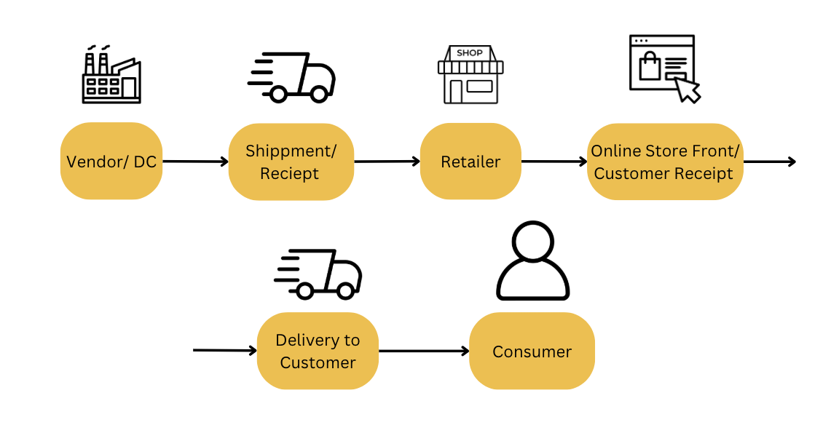
Buy Online Deliver From Store (BODFS):
Notes:
1) Goods are sold from vendor to retailer
2) Shipment and recipient is charged
3) Goods are stored at physical retail store
4) Consumer interacts with online storefront where they are charged
5) Shipment of goods to customer
6) Consumer receives goods
Recommend speaking about the process in joiner & sones hardware terms

Slide 7
Question 2 - On a second page identify the cost of each activity and the total delivered cost per unit for a, b, and c items for each proposed channel.
Rates and amount per unit changed from given activities:
Annual ICC store: 34.8% > 32% for all items
Annual ICC warehouse (BODDC only): 32.10% > 30% for all items
Return rate for items fulfilled from dc: 18% > 12% for item a, 32.1% > 30% for item b
Sales increase projected additional customer purchase when picking up the order: 18.2% > 15% for item A
Sales increase projected due to new BODDC channel: 5% > 8% for item B
Sales increase projected due to new BOPUS channel: 25% > 20% for item C
Notes:
For both Annual Icc store and warehouse: As a chain of 16 hardware stores with a single DC, we should have standardized process for our ABC distribution and should be running a tighter ship than our bigger competitors with much large distribution networks.
The return rates seem a bit high for hardware items which are durable items, I will say that Items A and B should be lowered as they are usually built to last items. C Items seems reasonable as they are consumables that can expire or be found defective more easily.
Lowering the % of sales increase for Items A seems reasonable as the items being bought are costly items being ordered online with the intent of immediate installation or with a project already in mind. The latter does let me believe it should be above 10% but 18.20% seems high so 15% sounds reasonable
I would say that there would be increase for these more expensive items to be delivered the whole way to customer's homes so they are not responsible for the transportation of larger or more costly items. I would say around 8% instead
As many of the C Items are consumables, they are less likely to be ordered online as most hardware stores should have a stock and varieties of screws, washers, nuts, lightbulbs, hoses, etc. If these are unique or specialized orders then it might make sense that it comes directly from the DC to be picked up at the store which is why it was only lowed by 5% to 20%.

Slide 8
TRADITIONAL | A Items | B Items | C Items
Average shipment weight (lbs) | 37.21 | 8.97 | 1.43
Operations DC | $0.12 | $0.10 | $0.08
Packaging for TL shipments | $0.12 | $0.08 | $0.06
Shipping DC to Store TL [per pound] | $0.07 | $0.19 | $0.27
Total Shipping DC to Store | $2.60 | $1.70 | $0.39
Operations Retail Stores | $0.60 | $0.30 | $0.10
Customer Service Retail Store | $0.12 | $0.10 | $0.08
Annual ICC Store | 32.0% | 32.0% | 32.0%
Annual Turnover | 1.61 | 3.22 | 9.73
ICC per unit | $19.88 | $2.48 | $0.16
Return Rate for Items Sold or Picked Up at Retail Store | 5.0% | 3.0% | 1.0%
Revenue Lost due to returns | $0.50 | $0.08 | $0.01
Returns cost to process | $1.18 | $0.97 | $0.76
Average Unit Cost | $100.00 | $25.00 | $5.00
Average Unit Price | $141.70 | $35.43 | $7.09
TOTAL TRADITIONAL RETAIL PER UNIT | $25.12 | $5.81 | $1.64
To the left is the example of calculations done to find the delivered cost per unit
Below we have the comparative summary of the four different channels of delivery for the hardware supply chain.
COMPARATIVE SUMMARY
 | A Items | B Items | C Items | Average
Traditional Retail | $25.12 | $5.81 | $1.64 | $4.82
BOPUS (Buy Online/Pick Up at Store) | $23.68 | $5.30 | $1.65 | $4.59
BODFS (Buy Online/Deliver From Store) | $35.59 | $12.25 | $6.03 | $10.23
BODDC (Buy Online/Deliver from DC) | $34.60 | $13.10 | $7.18 | $11.10
Proportion of Company Sales | 10% | 20% | 70%

Slide 9
Question 3 - Stephanie claims increasing sales will reduce the COGS on a PER UNIT basis. Wilson’s EOQ includes some of the logistics costs in COGS [assume annual demand is 1,000 units per year, ordering cost is $55 per order, annual inventory carrying cost is 34.8%, unit purchase price is $48, and sales increases by 24% annually].
Given :
Annual Demand (D) | 1000 Units
Ordering Cost (K) | $55
Carrying Cost (V) | 34.8%
Unit Price (C) | $48
Rate of Sale Increase | 24% annually

Slide 10
Formula to be used:
EOQ = Sqrt (2*D*K / I*C)
Total Ordering cost = (D/EOQ) * K
Total Carrying cost = (EOQ/2) * I * C
Total Purchase cost = D * C
Total cost of Goods sold = Total Purchase cost + Total Ordering cost + Total Carrying cost
Cost of Goods sold per unit = Total cost of goods sold / D

Slide 11
Cost of Analysis of COGS per unit Before and After Sales 24% Increase
Cost Component | Before Sales Increase | After Sales Increase | Change
Annual Demand | 1000 | 1240 | +240
Unit purchase Price | $48 | $48 | 0
Ordering Cost | $55 | $55 | 0
Carrying Cost | 34.8% | 34.8% | 0
EOQ | 81 | 90 | +9
Total Purchase Cost | $48000 | $59520 | $11,520
Total Ordering Cost | $679.01 | $757.78 | +$78.77
Total Carrying Cost | $676.51 | $751.68 | +$75.17
Cost of Goods sold per unit | $49.36 | $49.22 | -$0.14
Total Cost of Goods sold | $49.355.52 | $61,029.46 | +$11,673.94
Before the 24% sales increase, the cost of goods sold per unit was $0.14 higher than after the increase.

Slide 12
Question 4 : Recommend how we should handle the cost of shipping from the DC to the customer (BODDC) or from the store to the customer (BODFRS). Be sure to identify how your proposal will financially impact joiner & sons hardware
BODDC recommendation:
Standard rate for shipment to the customer
Utilize a 3rd party to reduce shipping cost
BODFRS recommendation:
Utilize a 3rd party to reduce shipping cost
Charge a standard rate for commonly sold sku’s
Increase unit cost rather than purchasing from in store
High dollar items will include free shipping and installation effectively giving the customer more purchase power
Cheaper items when truckloads (TL) are ordered for lower rates to decrease costs to stock store for dc
Notes:
Notes for presenter:
Example for context can be Lowes. For example, unique one-off items can be shipped direct to customer (wrench, screwdriver, etc.) For the BODFRS recommendation, an example to use for purchasing power is buying appliances from Lowes. If you buy an appliance from Lowes, they include shipping and installation. Helps incentivize to buy from them and effectively gives the customer a peace of mind. For the Truckload (TL) rates, be sure to incorporate this into buying items like roofing shingles from Lowes. Those are bought in huge quantity's and are usually either delivered to the store for pick up and straight to the customer.
For 3rd Partys, ensure to discuss that it can be based on a standard rate (monthly or annually) to promise to ship items at a lower cost if a certain amount of dollar value, weight in pounds, or items are ordered by the customers. AKA outsourcing.

Slide 13
Question 5 - Propose how we should handle customer returns. Be sure to identify How your proposal will financially impact Joiner & Sons Hardware.
We should offer a 30-day return policy.
We should offer store credit rather than a refund.
Customer convenience and satisfaction should be the focus – physical store return and shipping back to the dc where we handle shipping costs.
If the item is in good condition then it can be resold immediately.
If the items are damaged, the "backhaul” method for items that need repairs at the DC.
Notes:
This 30-day policy will prevent returns after the time window and place the responsibility on the customer lowering customer satisfaction but not by much
We can offer store credit instead so that we do not lose their money, we can offer a full refund if they push for a refund (say it needs manager approval)
As Stephanie mentioned, UPS reports indicate that 82% of shoppers are more likely to buy online if they can return the product to a store
Backhaul – Place returns on TL or LTL delivered from the DC as the empty space created by delivered can be filled as they return to the DC
We are assuming that the rate to ship from the DC to the customer would be the same in reverse

Slide 14
Question 6 - Identify three other concerns when setting up the multichannel and propose solutions. Again, you may use a slide to summarize your key takeaway points to point out your quantitative and qualitative analysis, with key takeaways.
Concerns:
1. Inventory challenges – Difficulties can arise when dealing with multiple channels of demand. Cost of having larger inventory due to multiple channels.
2. Customer service online vs in person – Will the service for both in person and online customers be equal?
Reduction of instore customers – Will other channels diminish the instore customer demand significantly enough to where the store is no longer worth operating?

Slide 15
Solutions: 1) Be sure to analyze accurately to know the exact demand in order to prevent under/overstock (in turn can help with managing inventory cost). 2) Ensure that both online and in person customers are receiving the same benefits. 3) Make sure to continue servicing the instore customers successfully in order to reduce lack of in store customers. Provide equally fast and efficient service across channels.

Slide 16
Thank you
Aaron Thomas
Indhu Biruduraju
Brad Branscum
Ruben Garcia
Carmen Trevizo Kyle Porter

